Slide 1






FAC BULLS
M&A RAINMAKER
IIM CALCUTTA

Slide 2


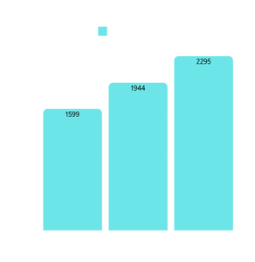

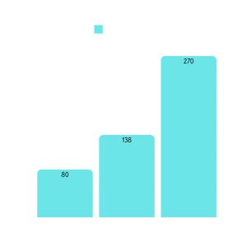
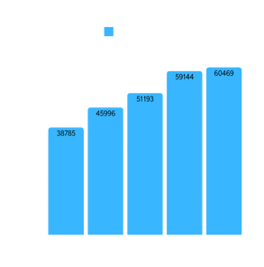

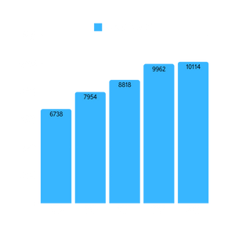
COMPANY OVERVIEW
BIKAJI
HUL
HISTORY &
OVERVIEW
Founded in 1987 by Shri Shivratan Agarwal in Bikaner, Rajasthan. The company has grown to become one of India's largest manufacturers of ethnic snacks, offering a wide range of products like bhujia, namkeen, papad, and sweets.
HISTORY &
OVERVIEW
Established in 1933 under the name Lever Brothers India Limited, a collaboration between the British multinational Unilever and the Indian market.
One of India's largest and most diversified FMCG companies, offering a vast portfolio spanning personal care, home care, food and beverages, and health products.
FINANCIAL
TRANSACTIONS
Has investments from private equity players like Lighthouse Funds and IIFL. It went public in November 2022, raising capital to fuel further expansion..
FINANCIAL
TRANSACTIONS
Listed on both the NSE and BSE, HUL has consistently demonstrated solid financial growth.
In 2021, HUL successfully raised capital through a rights issue
Expanding retail and e-commerce reach, building a premium ethnic snack brand, growing through franchise restaurants, and employing rural contractors for production scalability.
Enhancing its product portfolio, focusing on sustainability, expanding digital sales channels, and leveraging rural distribution networks to increase market penetration.
STRATEGY
STRATEGY
74.98%, is primarily held by its promoters, with the remaining 25.02% held by public shareholders
Unilever holds a controlling stake of approximately 61.9% in the company, while the remaining 38.1% is held by public shareholders.
OWNERSHIP
OWNERSHIP
Current Share Price: ₹818.80
52-Week High/Low : ₹1005 - ₹475
Return YTD: +50.25%
STOCK
PERFORMANCE
STOCK
PERFORMANCE
Current Share Price: ₹2,485
52-Week High/Low: ₹3,035- ₹2,172
Return YTD: -6.91%
D2C CHANNELS
D2C CHANNELS

Slide 3

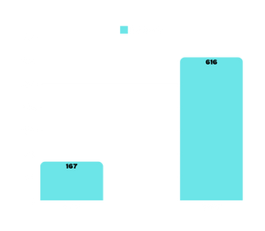
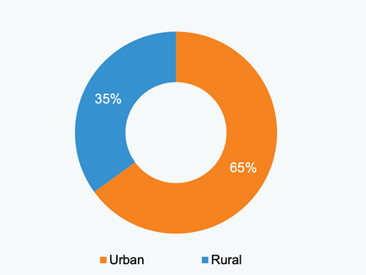
INDUSTRY OVERVIEW
As per NielsenIQ, during Q3 FY24, the volume of the industry exhibited a YoY growth of 6.4%, while anticipating growth between 4.5% to 6.5% in 2024.
Total revenue of FMCG market is expected to reach nearly to US$ 615.87 billion in 2027.
The Indian D2C market is growing at a CAGR of 40% (FY22-27P). The combined revenue of D2C brands is expected to hit US$ 60 billion by FY27 from US$ 12 billion in FY22.
D2C CHANNELS
CAGR 27.9%
Union Budget 2023-24 has allocated US$ 976 million for PLI schemes that aims to reduce import costs, improve the cost competitiveness of domestically produced goods, increase domestic capacity, and promote exports.​
POLICY SUPPORT
In the third quarter of 2023, urban markets experienced an enhancement in the non-food sector, witnessing a consumption growth rate of +10.4%, which marked an increase from the previous quarter's +8.9%.
2022
The E-Commerce segment is projected to contribute 11% of overall Indian FMCG companies’ sales in 2030.
FMCG companies are looking to invest in energy-efficient plants to benefit society and lower costs in the long term.
Amazon aims at making all shipments net-zero carbon, with 50% net zero carbon by 2030.
STRATEGIC FOCUS
ITC Ltd.'s Chairman and MD, Mr. Sanjiv Puri, announced a mid-term capex plan of ₹20,000 crore (US$ 241.55 million) to expand FMCG, paperboard, and other business capacities.
In February 2024, Varun Beverages announced of investing Rs. 3,500 crores (US$ 421.69 million) to setup manufacturing plants.
INVESTMENTS
Limited Storage Space
Seasonality and Demand Variability
Product Shelf Life and Fragility
Regulatory Compliance and Quality Control
CHALLENGES

Slide 4

PRECEDENT TRANSACTIONS IMPACT
1. Dabur India Ltd. Acquisition of Badshah Masala
Impact on Financials:
Positive : Dabur witnessed increased revenue diversification and market share in the spices category.
Enhanced EBITDA margins in subsequent quarters due to economies of scale.
2. ITC Ltd. Acquisition of Sunrise Foods
Impact on Financials:
Positive : Sunrise Foods contributed significantly to ITC's FMCG revenue growth (~16% CAGR in the segment post-acquisition).
Improved operating margins as ITC utilized its strong distribution channels.
ITC successfully integrated Sunrise into its portfolio.
3. Hindustan Unilever Ltd. (HUL) Merger with GSK Consumer Healthcare
Impact on Financials:
Positive : HFD category became a key growth driver, with revenue contribution exceeding ₹5,000 crore annually.
Significant improvement in EBITDA margins, reflecting cost synergies and brand premiumization.
4. Zydus Wellness Acquisition of Heinz India Pvt. Ltd.
Impact on Financials:
Positive : Boosted top-line growth, with sales increasing significantly post-acquisition.
Enhanced operating margins due to synergies in marketing and distribution.
Negative : Debt taken to finance the acquisition increased financial risk.

Slide 5

FINAL THESIS
HUL should acquire the 51% majority stake in Bikaji Foods International Ltd.
Revenue Diversification
Bikaji Foods operates in the rapidly growing ethnic snacks segment, which has seen strong consumer demand due to increasing urbanization, changing lifestyles, and consumer preference for traditional flavors.
The acquisition would provide HUL access to Bikaji's robust revenue streams, which are highly concentrated in high-margin snack products.
Market Leadership
The ethnic snacks segment is projected to grow at a double-digit CAGR (about 27.9%) over the next decade. With Bikaji in its portfolio, HUL would establish itself as a dominant player in a fast-expanding market.
High-Growth Segments
The acquisition aligns with HUL’s focus on entering high-growth and high-potential categories, in line with its strategy of driving future-ready growth in India.
Synergies
Operational synergies from integrating manufacturing facilities, logistics, and supply chains would lower costs and improve efficiency, enhancing profitability.
Selling Opportunities
HUL could leverage its well-established distribution network to cross-sell Bikaji’s products, significantly increasing Bikaji’s market penetration, especially in under-tapped urban areas and Tier-2/3 cities.
Bikaji’s portfolio could be expanded into international markets through HUL's global distribution channels, unlocking new revenue streams.

Slide 6
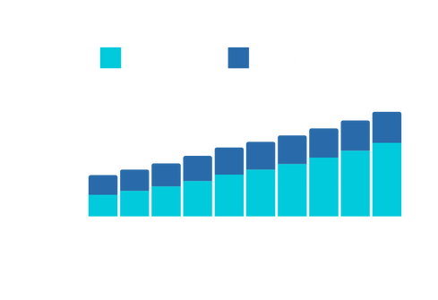


Valuation Analysis
DCF MODEL
COMPARABLE COMPANIES MODEL
PRECEDENT TRANSACTIONS MODEL
A valuation method that estimates the value of an investment using its expected future cash flows.
EV/Revenue Multiple : ₹705.62
EV/EBITDA Multiple : ₹695.52
EV/Revenue Multiple : ₹538.03
EV/EBITDA Multiple : ₹508.04
INTRINSIC VALUE | ₹464.57
UPPER BOUND | ₹511.02
LOWER BOUND | ₹418.11
Insight:
These multiples suggest a fair value share price significantly higher than the DCF range.
It reflects Bikaji's positioning as a strong player in the ethnic snacks market and aligns well with industry benchmarks.
However, this valuation assumes that Bikaji’s growth prospects and market share justify a premium, which HUL must critically evaluate.
Insight:
These valuations are close to the DCF range and reflect what strategic buyers have historically paid for companies in the snacks/FMCG sector.
These valuations offer a reasonable benchmark for a negotiated price but may not factor in Bikaji’s unique value drivers, such as its strong brand and potential synergies with HUL.
We have taken valuable insights from each of these three valuation models to arrive at the final fair value share price range for the deal .
Excel Valuation Model Sheet Link

Slide 7


DEAL OFFER
HUL should acquire the 51% majority stake in Bikaji Foods International Ltd.
Control Premium
Justification for the Price Range
Acquiring a 51% majority stake typically involves a control premium (30–40% above fair value) to reflect the buyer's ability to direct the company’s operations and strategic decisions.
Since Bikaji’s intrinsic value (based on DCF and Precedent Transactions) ranges between INR 418–538, a control premium would bring the acquisition price to approximately INR 550–750 which is close to the Comparable Companies Valuation price .
Value Justification:
The price range reflects Bikaji’s fair value based on different valuation models adjusted for synergies, growth potential, and control premium.
Risk Mitigation:
Paying above INR 750 could lead to overpayment risks, especially if Bikaji fails to meet growth expectations or if integration challenges arise.
Competitive Advantage:
Acquiring Bikaji at a fair price enhances HUL’s strategic positioning in the ethnic snacks segment without significantly straining its financial resources.
Payment
Proposed Acquisition Price Range:
Lower Bound: INR 550 per share (based on intrinsic and precedent valuation).
Upper Bound: INR 750 per share (including control premium and strategic synergies).
Majority Stake Payment:
For a 51% stake, HUL should pay INR 7,012.5-9,562.5 crore (assuming 25 crore shares outstanding), depending on the negotiated share price within the proposed range.
5Y Forecasted Revenue and EBITDA (after Acquisition)

Slide 8

THANK YOU
FAC BULLS (IIT KANPUR)

